Slide 1
NYPD Shooting Incident Report
Presented by: Anubhav Sharma
Last Updated: April 25rd, 2022
Notes:
Hello

Slide 2
Table of Contents
Introduction
Part 1: Tidying the NYPD Data Set
Part 2: Visualizations and Analysis
Part 3: Model
Part 4: Bias Sources
Conclusions
Appendix

Slide 3
Introduction

Slide 4
Objective
Tidy the NYPD Shooting Incident Data (Historic)
Perform the Analysis and make Visualizations to understand the data
Make a linear model for the NYPD Data
Identify Bias Sources
Summarizing the findings

Slide 5
NYPD Shooting Incident Data Set
A huge data set containing list of every shooting incident that occurred in NYC going back to 2006 through the end of the previous calendar year. (We will remove some observations to allow us to analyse properly)
Each record represents a shooting incident in NYC and includes information about the event, the geo-location data related to the event, and additional information about victim and suspect.
Data set is intended for public access and use. It can be accessed via this link: https://catalog.data.gov/dataset/nypd-shooting-incident-data-historic

Slide 6
Part 1: Tidying the NYPD Data Set

Slide 7
Tidying Process
During the whole process many steps were taken to make the raw data suitable for further analysis.
For the sake of this presentation only a brief overview will be presented. Kindly look through the report or R files linked in the appendix for more detailinformation.

Slide 8
Tidying Process
1
2
3
Importing data and transform variables like DATE and MURDER_FLAG into proper format for further analysis.
Removing variables related to Geo-Location information, OCCUR_TIME, and others which could be used to identify individual event. Also, remove the variables not considered necessary for the analysis.
Removing Unknowns, blanks, outliers, “NONE”, and other errors in the data set. Finally, rearranging the order of variables

Slide 9
Part 2: Visualizations and Analysis

Slide 10
Questions of Interests
In Part 2 we will form our analysis on the based of seven questions
In which day and month most of the incidents happen? Can we identify a visible trend in the findings?
In which day and month most of the murders happen? Can we identify a visible trend in the findings?
What is the distribution of Shooting incidents leading to murders across the different regions in New York? That is to find which region reported most murders and which region reported the least.
At which type of locations most of incidents and deaths happen in the New York?
What is the trend of Shooting Incidents and Murder Incidents across the Years?
What is the proportion of different genders falling under the categories of Victim and Perpetrator across the Years?
What is the proportion of different races falling under the categories of Victim and Perpetrator across the Years?

Slide 11
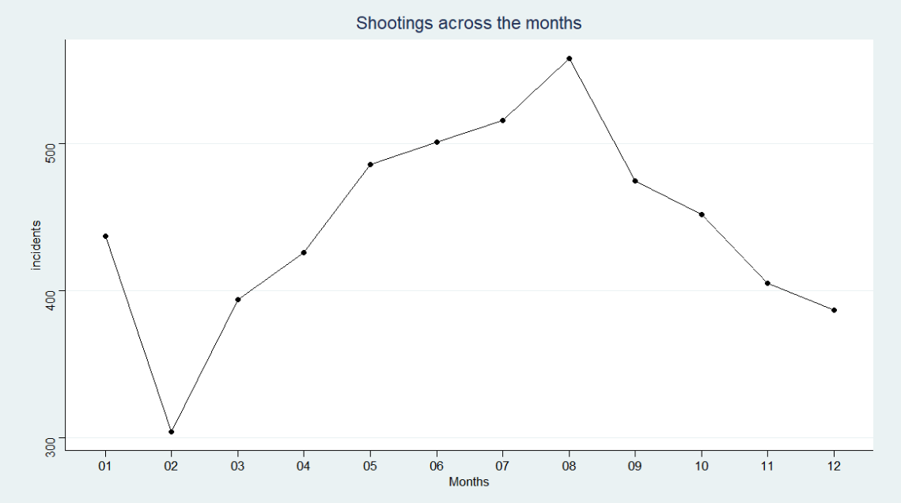
In which day and month most of the incidents happen? Can we identify a visible trend in the findings?
Key Takeaways
Number of incidents increases from February in a linear fashion before they reach their peak in August and starts falling down again.
There exist a seasonal pattern in the shooting incidents in New York.
We need more data to analyse this trend further.
Notes:
Here we have used line charts to identify the trends across the months/

Slide 12
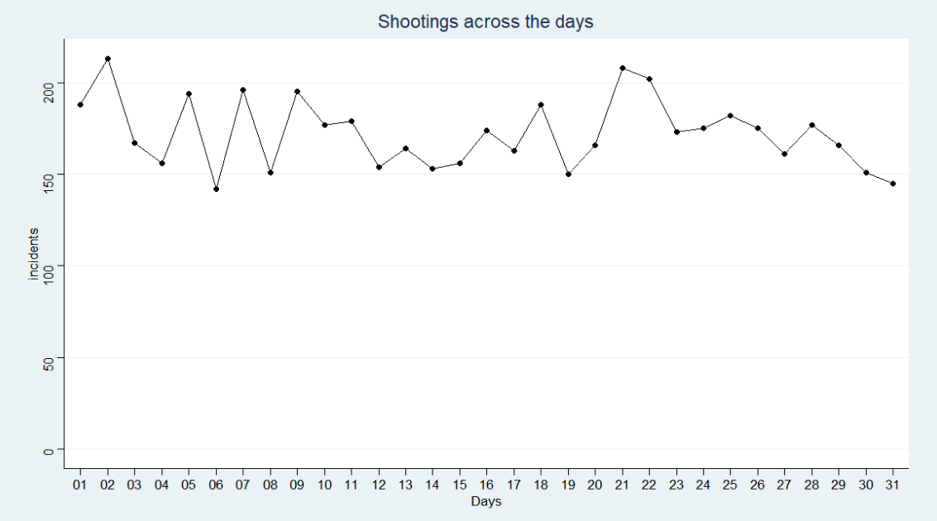
In which day and month most of the incidents happen? Can we identify a visible trend in the findings?
Key Takeaways
Number of incidents move up and down quite frequently.
Most of the time when incidents go above a threshold of 170 they fall back within the threshold next day.
Graph peaks at two points: 2nd and 21st. One at the beginning of the month and other near the end.

Slide 13
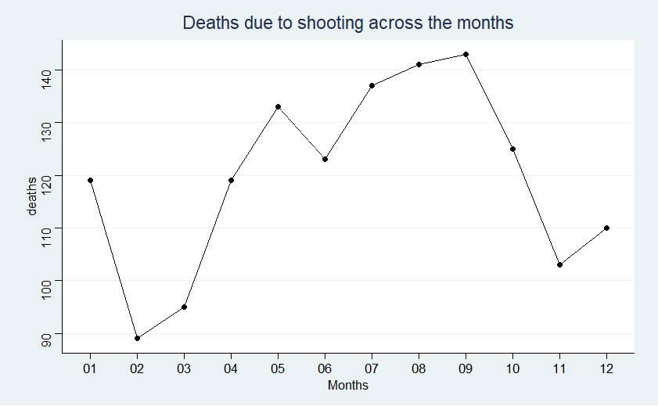
In which day and month most of the murders happen? Can we identify a visible trend in the findings?
Key Takeaways
Number of deaths increases from February in a linear fashion before they reach their peak in September and starts falling down again.
There exist a seasonal pattern in the murders due to shooting incidents in New York.
This rise and fall is similar to the incidents graph.

Slide 14
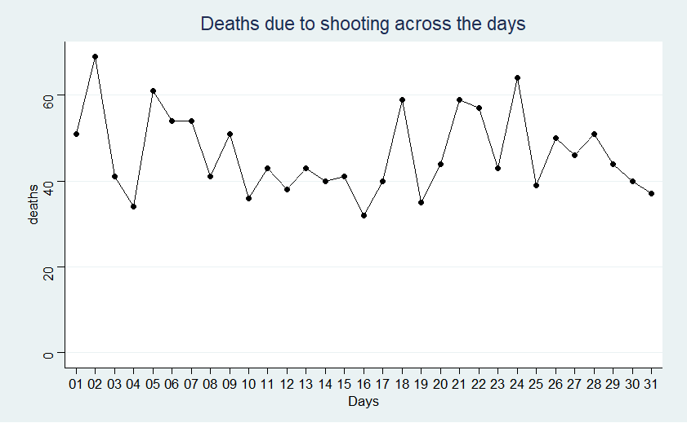
In which day and month most of the murders happen? Can we identify a visible trend in the findings?
Key Takeaways
Number of deaths move up and down quite frequently.
Most of the time when incidents go above a threshold of 45 they fall back within the threshold next day.
Graph peaks at two points: 2nd and 24th. One at the beginning of the month and other near the end.

Slide 15
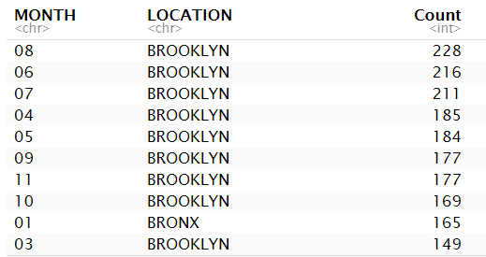
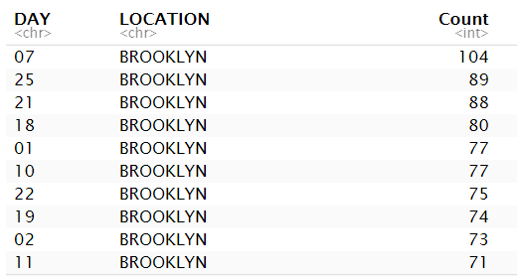
As an additional analysis to first two questions we will look at Top 10 months and days with most incidents grouped by regions
The whole list is mostly populated by Brooklyn. While Bronx took top spot for the month of January Brooklyn is the region with most number of incidents in rest of the 11 months.
Here not even one spot has been taken by region other than Brooklyn. In fact, out of 31 days Bronx had counts in 4 days, in 27 days Brooklyn recorded most shooting incidents.
The above analysis shows that most of the shooting incidents appear to be happening in Brooklyn. We will explore similar analysis for murders in next slide while answering Question 3.
Notes:
Here instead of graphs we are using two tables showing top 10 counts.

Slide 16
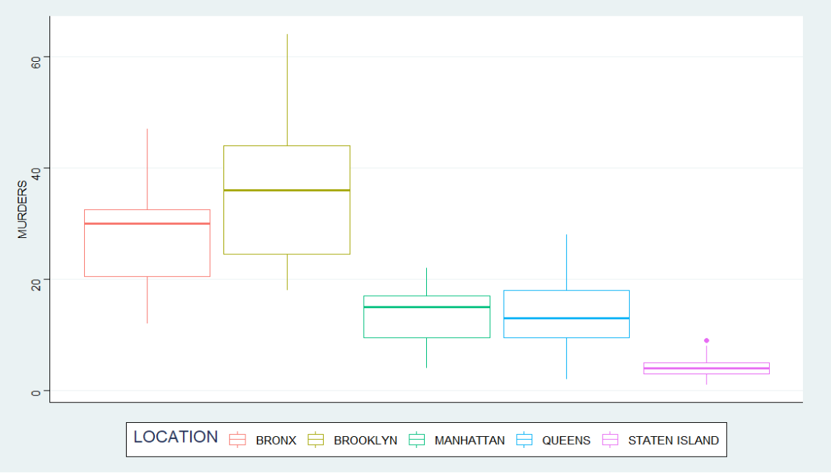
What is the distribution of Shooting incidents leading to murders across the different regions in New York?
Key Takeaways
Brooklyn recorded highest record of murders during the period.
Staten Island recorded least murders during the period.
Brooklyn has a mean of 36.2 Murders reported in each year while Staten Island has a mean of only 4.2 Murders per year.
Notes:
A box and whisker plot—also called a box plot—displays the five-number summary of a set of data. The edges of the box shows us the 1st and 3rd quartiles and the middle line represents median while the whiskers shows lowest and highest data points.

Slide 17
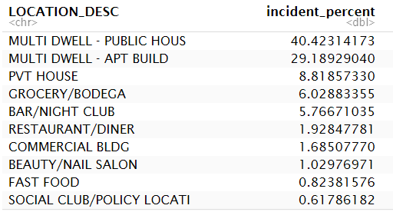
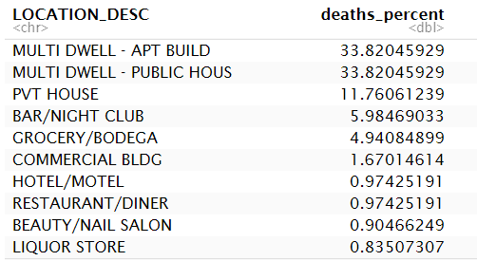
At which type of locations most of the incidents and murders happened in the New York?
69.5% of shooting incidents and 67.6% of the murders resulting from them in the happened in multi-dwelling buildings such as Apartment Buildings and Public Housing units.
Public places like bars, clubs, and stores only amount to 21.7% of the shooting incidents and 20.7% of the deaths meaning that around 80% of the deaths and incidents happen in the residential areas including private houses.

Slide 18
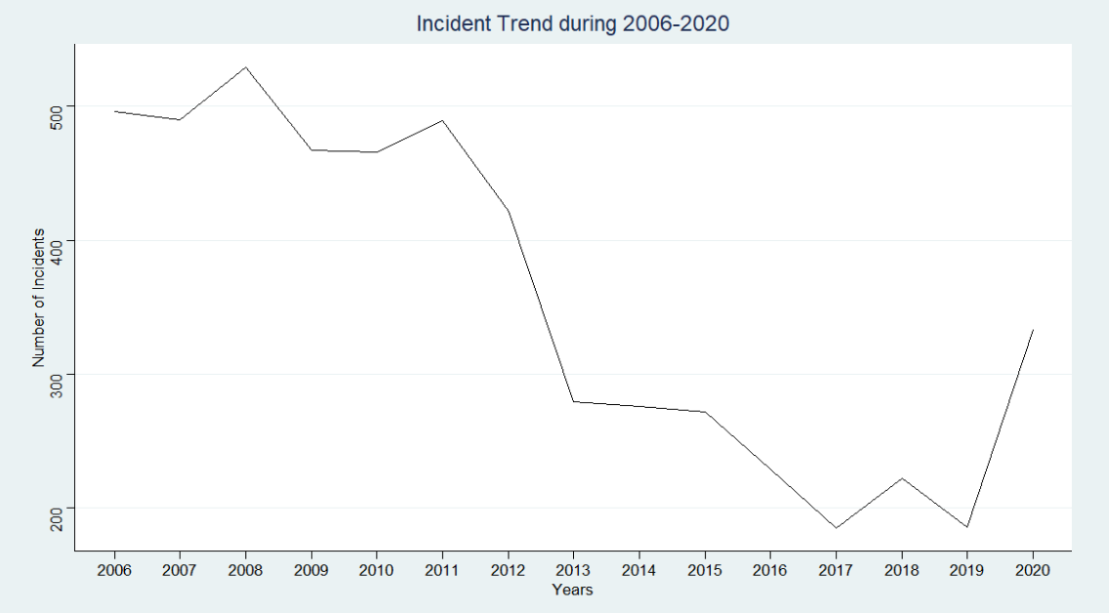
What is the trend of Shooting Incidents and Murder Incidents across the Years?
Key Takeaways
Shooting incidents have been decreasing across the Years in the New York.
A recent spike has been recorded in 2020. There could many reasons for this, we need more data to examine this further.

Slide 19
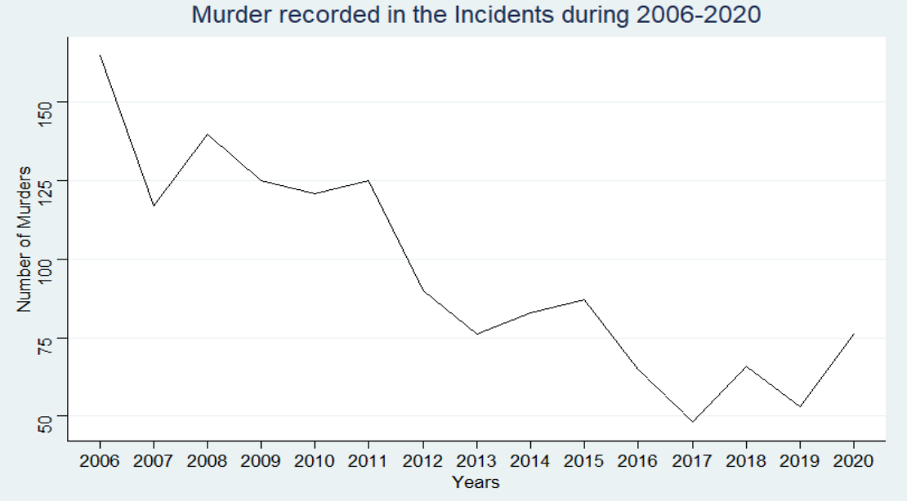
What is the trend of Shooting Incidents and Murder Incidents across the Years?
Key Takeaways
Just like incidents, the Murders were decreasing across the years but spiked in 2020.
There appears to be a linear relationship between shooting incidents and murders, we will examine this further in Part 3.

Slide 20
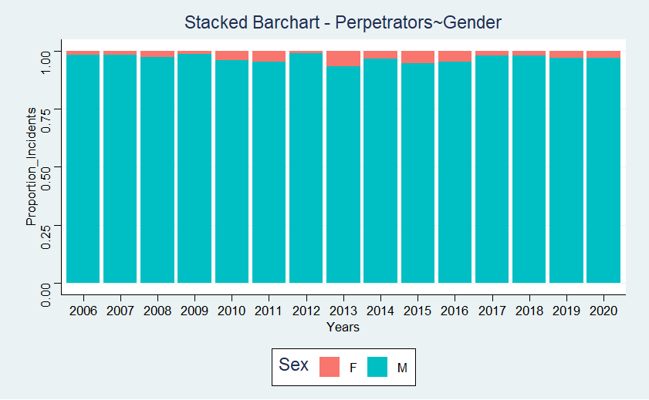
What is the proportion of different genders falling under the categories of Victim and Perpetrator across the Years?
Key Takeaways
In all the years, more than 90% of the perpetrators were Males.
Year 2013 recorded highest percentage for female perpetrators.
Notes:
Stacked bar chart is used here because they do a good job of featuring the total and also providing a visual cue as to how the total for each category value is divided into parts.

Slide 21
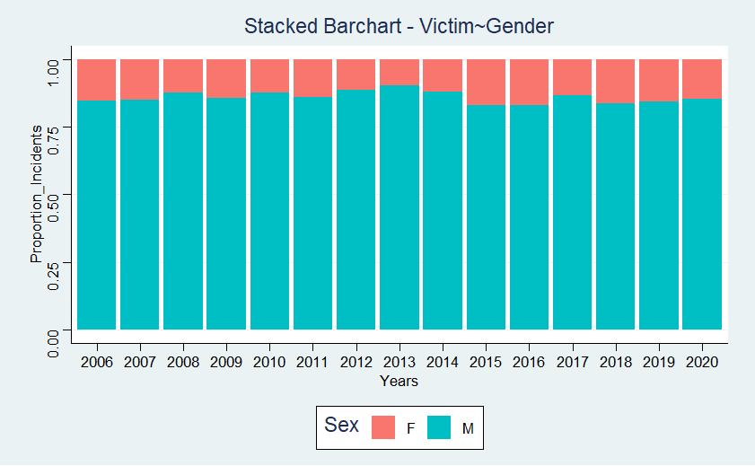
What is the proportion of different genders falling under the categories of Victim and Perpetrator across the Years?
Key Takeaways
Men are the major targets of the incidents.
Proportion of Women as Victims far exceeds their proportion of being the perpetrators of the shooting incidents.

Slide 22
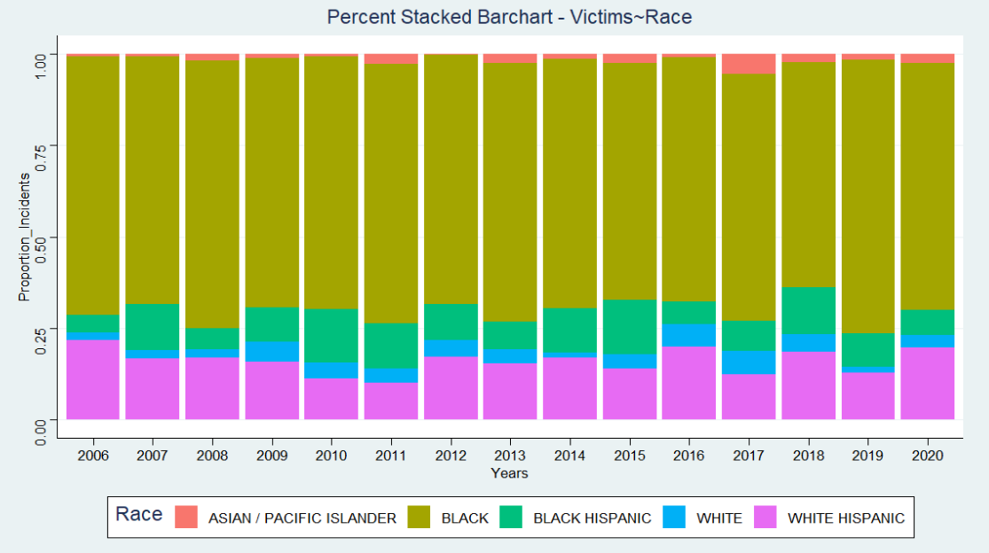
What is the proportion of different races falling under the categories of Victim and Perpetrator across the Years?
Key Takeaways
At least 65% of the victims were Blacks every single year.
Asian/ Pacific islanders are least targeted race in graph.
Note: AMERICAN INDIAN/ALASKAN NATIVE had 2 counts over whole period. They are the actual least targeted race across the period. This information was removed to create a more readable graph.

Slide 23
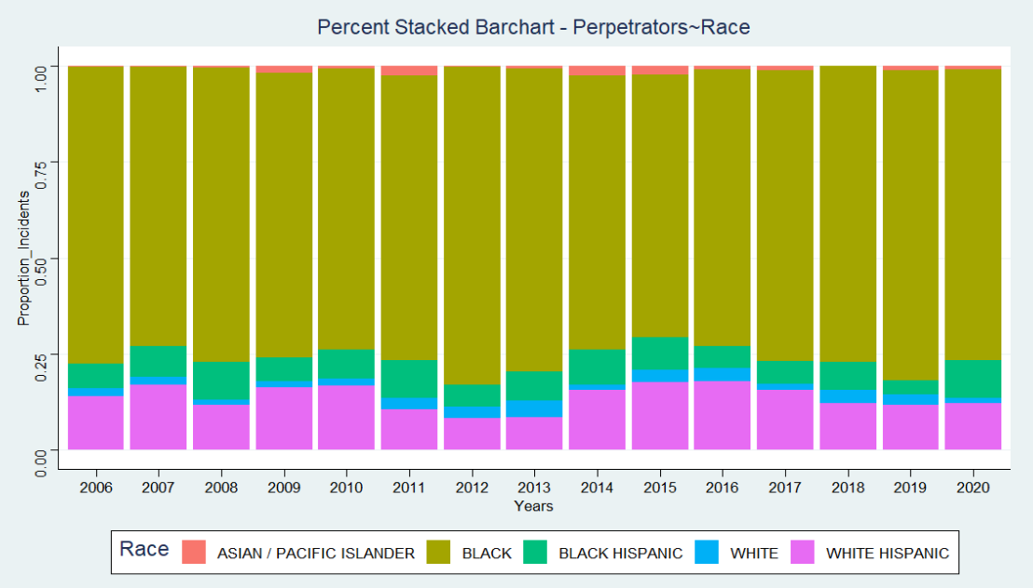
What is the proportion of different races falling under the categories of Victim and Perpetrator across the Years?
Key Takeaways
More than 75% of the perpetrators were blacks every single year.
Asian/ Pacific islanders have least proportion in the graph.
Note: AMERICAN INDIAN/ALASKAN NATIVE had 1 count over whole period. This information was removed to create a more readable graph.

Slide 24
Part 3: Model

Slide 25
Introduction
In this Part 2 during the analysis we saw that number of shooting incidents and murders appear to be following a linear relationship.
To examine this further we will create a linear model to predict the Number of Shooting Incidents across the years and regions on the basis of the number of Murders recorded.

Slide 26
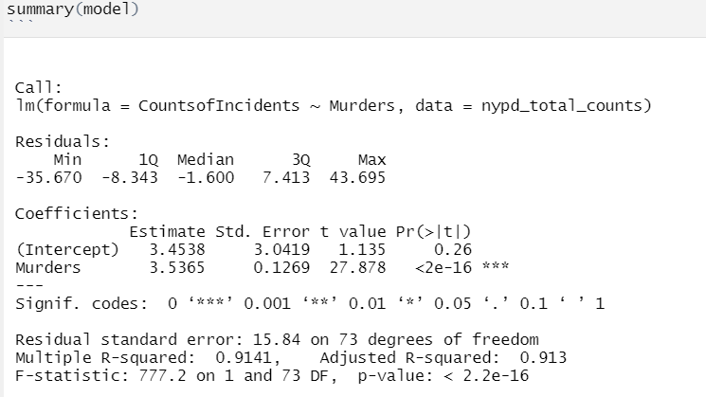
Linear Model
In the preliminary analysis of the model we can see that Adjusted R-Squared has value of 0.913 signifying that model is a great fit for the data.

Slide 27
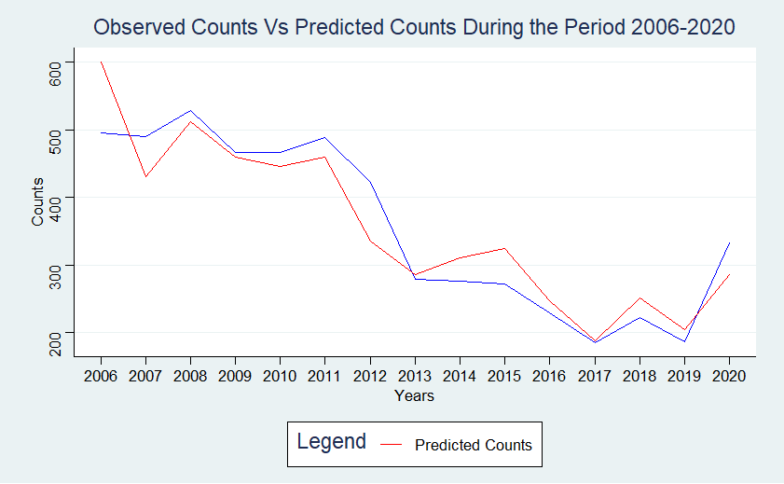
Linear Model
Predicted counts, derived on the Murder data, follows the observed data quite properly.
There exist a linear relationship between number of shooting incidents and the number of murders resulting from these incidents.

Slide 28
Part 4: Bias Sources

Slide 29
Bias Sources
Bias identification is an important part of any Data Science Project. On this slide you can see the Bias Sources identified throughout the reporting process.
A preconceived bias about Brooklyn known popular for Shooting Incidents on the basis of media reports. To mitigate it all the regions were considered equally in the process.
Any information which could have been used to identify individual case has been removed during the Part 1. This information could have been used to find when does most of the incidents occur in the different locations while being able to predict race of Victim and Perpetrator. Also, the GPS data could have been further used to find the real names and locations of all the parties recorded being involved in the incidents. All this Data was removed to ensure maximum anonymity in each case.
A preconceived bias that a particular race falls under the category of Perpetrators most of the time. This bias originated once again from media reports I obtained in my country. To mitigate it, all the races were considered equally in the concerned processes.
A bias in general that a huge number of shooting incidents happen in the US. This bias helped me to do more research than required in the assignment's grading scheme to fully satisfy my curiosity.
A few filters were introduced during the process to make more visually appealing and easy to understand graphs. To mitigate it, special notes have been introduced in the report. This Part 2 during the analysis we saw that number of shooting incidents and murders appear to be following a linear relationship.
To examine this further we will create a linear model to predict the Number of Shooting Incidents across the years and regions on the basis of the number of Murders recorded.

Slide 30
Conclusions

Slide 31
Conclusions
1
2
3
Shooting incidents and murders across the months for the period follow a seasonal cycle with both of them having lowest count in February and continues to a rise in a linear fashion until they reach the peaks in the month of August and September respectively before eventually falling down, again in a linear fashion.
Shooting incidents and murders across the days for the period don't follow any specific cyclic pattern but whenever they goes beyond a threshold on a specific day they fall back within the threshold in the next day. More data is required to examine this erratic trend.
78.4% of the total shooting incidents and 79.4% of the deaths resulting from such incidents have been recorded from residential areas containing multi-dwelling units like apartments and public housing units and private homes. This means that only 20% of such events happen in public places like stores and bars meaning that staying outdoor is much safer than being indoor in the New York.

Slide 32
Conclusions
4
5
6
Shooting Incident Rates and Murder Rates has been falling in general but spiked in 2020. It can be a temporary spike due to global pandemic amid other factors, need more data besides this data set to gain a complete picture on this point.
Not every region in New York record same numbers. The number of incidents leading to murders vary quite a bit with Brooklyn having mean of 36.2 murders reported in each year while Staten Island has a mean of only 4.2.
And since we have seen a linear relationship between Murder Rates and Incident Rates in Part 3 we can infer that same must be true for number of incidents.
There exists a linear relationship between the Number of Incidents and Numbers of Murders in the regions across the years.
This relationship could be reduced through various methods like providing better treatment to the victims and others with which deaths due to these incidents could be reduced.

Slide 33
Conclusions
7
There is a huge imbalance in the proportion of perpetrators and victims in New York with Blacks covering them at least 75% and 65% respectively. This shows that most of the individuals involved in the shooting incidents in New York are Blacks, and mostly Men, as we saw that more than 90% of all the perpetrators in the shooting incidents are men.
Note:
All the above conclusions are based on the process followed in the report and are subjected to the bias sources identified in Part 4. They are not conclusive and hence, we must be cautious in accepting these conclusions as they could change if one could use data from different sources.

Slide 34
Appendix

Slide 35
This report is based on the data available at https://catalog.data.gov/dataset/nypd-shooting-incident-data-historic
More detailed explanation, visualizations, and analysis could be found in the PDF report and RMD version of the report at https://github.com/anubhav-ds/NYPD-Shooting-Incident-Report

